Slide 1

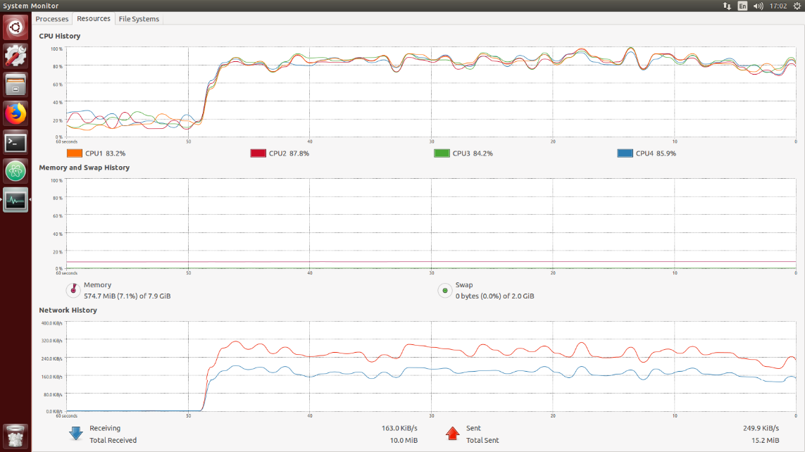
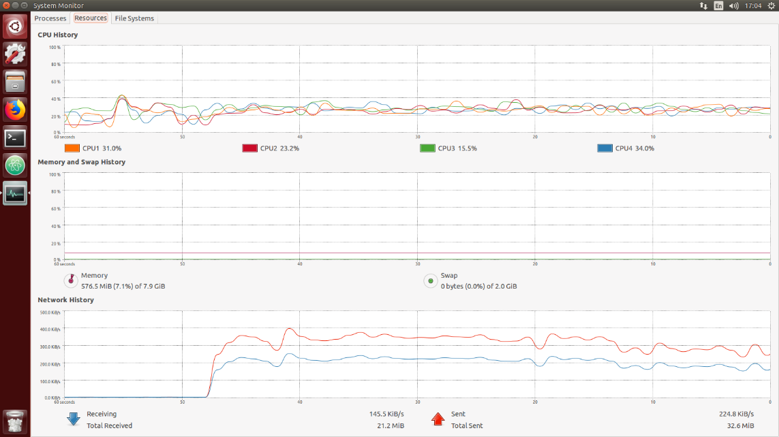
CS5331 Web Security – ReDOS
Group Members – Xiao Yikai, Zhang Xinyue, Huang Kun, Miao Anbang
School of Computing, National University of Singapore
Introduction
Regular Expression Denial of Service (ReDOS) is a Denial of Service attack that exploits on imperfect implementations using regular expression with extreme and specially designed patterns, to cause the target to respond very slowly or even temporally not able to provide service to normal users.
These patterns, called Evil Regex, can be used to attack every layer of the web application, such as browser, mobile device, web application firewall, web server, or even database. In this project, we studied ReDOS attack on web servers and how can we prevent it.
Regex Logic & Attack Logic
Objective
Our project aims to identify the logic of Regex checking and its vulnerability of being attacked
Demonstrate how attackers can attack on vulnerable servers and occupy the resources of target machines.
Figure out and verify solutions to this ReDOS attack
Results:
Below is the Resource Monitor comparison of a web server between a vulnerable PHP site and a redos protected site.
Vulnerable site under attack:
The cpu usage is significantly higher than normal
ReDOS protected site under attack:
The cpu usage is almost the same as nomal
Solutions
Input Validation (check the length of string before checking Regex): Since the time is increasing exponentially with the length of the string, a possible way of preventing the attack is to filter those long inputs.
Flaw Checking (avoid using vulnerable Regex pattern): It is not possible to avoid using Regex, but it is possible to avoid using vulnerable patterns. Make sure not using patterns like /(a+)+$/ or some hard to identify ones like /([a-z, 0-9]+)+$/
ReDOS Attack Experiment
Web Server: PHP web server with simple function is deployed. This server simulates a login page and it verifies username input with Regex of /(a+)+$/. Both legal the illegal message will be returned to client who calls it.
Normal Client: Web browser (specifically Firefox) is used as normal client to request.
Vulnerability Detection: Web browser is used to detect the vulnerability by requesting using malicious string.
DOS Attack: A bash script is used to attack server. Requests are sent in group of 1000. New group of requests are sent after the previous group finishes.
Observation: Two observation methods are adopted. One is to observe the resources on the server machine. Another one is to observe response time from a separated request.
Solution Verify: A new PHP web server with solution (avoid using vulnerable Regex) is deployed. Same ReDOS attack is conducted. And same observations are done.
Conclusion and Future Work
ReDOS Attack can be reproduced on PHP server with vulnerable pattern and string.
We have also tested the vulnerable Regex pattern and string using other language, namely JavaScript and GoLang. It shows that JavaScript has the same issue but GoLang does not. Future explore can be conducted on different Regex implementation in different language.
Other Application DOS attacks caused by server logic can also be further studied, eg. PHP hash collision.

